Slide 1
RADWIN
Soluciones de Conectividad
Neuquen, Oct 2019
Ariel Macchi
Channel Sales Director LatinAmerica

Slide 2



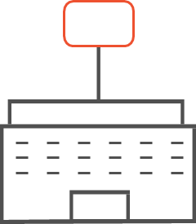

RADWIN at a glance
El partner confiable
Creciendo
desde 2003
Base Instalada
> 1,000,000 radios
17 Oficinas
En el mundo
Despliegues en
+ 170 paises
HQ
En Israel
Notes:
We’re growing consistently since 2003
We did it mainly by a strong innovation and passion to address our customers challenges and introduce new values.
Our radios are deployed in over 170 countries and the installed base is over 1M radios – a significant number for a Telecom infrastructure player.
Our HQ is in Israel, we have 17 offices worldwide and out of Israel

Slide 3


Liderando a través de la Innovación
60GHz mesh and TVWS
Dual band radio &
2nd gen. BF
PtMP with
BF antenna
NLOS
Backhaul
BF antenna l
TDMA
PtMP
GPS &
TDD Sync.
2019
2004
2011
2013
2015
2018
2019
Notes:
Innovation is a key to our continuous growth over the years. For example:
In 2004, we were the first to introduce GPS synchronization to 802.11 chipset, (removing the contention mechanism of the standard and enabling co-located radios) Our PtP delivered E1/T1 services using WiFi chipset that deployed worldwide by operators for cellular backhaul.
In 2011, we introduced the first PtMP system that was focused on the business customers with unique CIR service, and assured SLA that provided the highest capacity for that time.
In 2013 we introduced the best in market NLOS backhaul for small cells , working in 5GHz unlicensed band while using beamfoming antenna. It was operational first by Verizon USA and later was deployed by T-Mobile and Sprint (US)
In 2015 we introduced the first PtMP with beamfoming antenna for Fixed wireless access application. A game changer solution that enabled to deliver the greatest performance in noisy spectrum
In 2018, We introduced the first dual band base-station in 3 and 5 GHz bands accompanied with a 2nd generation beamforming antenna
In 2019 we will bring new solutions that will be discussed later on today.

Slide 4



User throughput
Challenge: Capacity
Challenge: NLOS & range
5000 Mbps
3500 Mbps
60Ghz
Partner With Facebook
1000 Mbps
500 Mbps
300 Mbps
100 Mbps
Sub 6GHz
Connect the unconnected
Enhance broadband to the connected
50 Mbps
30 Mbps
TVWS
Partner With Microsoft
10 Mbps
Urban
LOS
Suburban
LOS, nLOS
Rural
LOS, Vegetation
Range
Notes:
The 60GHz (mmWave) and the TVWS expend the performance envelope beyond that of the sub 6GHz portfolio:
The 60GHz solution expands RADWIN portfolio for urban and suburban that requires more capacity and used as complimentary solution of fiber.
The TVWS solution expends RADWIN portfolio for rural areas where NLOS is more common (less the capacity)
The 60GHz improves performance for already served customers, while TVWS connects the unconnected

Slide 5
RADWIN Portfolio
Point-to-Point
RADWIN 2000
10Mbps to 750Mbps
Point-to-MultiPoint
RADWIN 5000, JET, JET DUP
1.5Gbps
Mobility
FiberinMotion
750Mbps
Smart-Node
Network Planner
& Management
Notes:
Líderes en equipamiento de alta capacidad para extensión de FFOO o para generar coberturas de Alta capacidad en áreas amplias
Desarrollo una solución especial para transporte que es hoy una de las principales en el mundo
Desarrollo de soluciones para la problemática de un punto de conectividad fija
Una solución de gestión de red con altas prestaciones

Slide 6



Mercados
Proveedores de Servicio
Industrias Estrategicas
Transporte
Notes:
Main focus Service providers : Fixed and mobile carriers worldwide

Slide 7
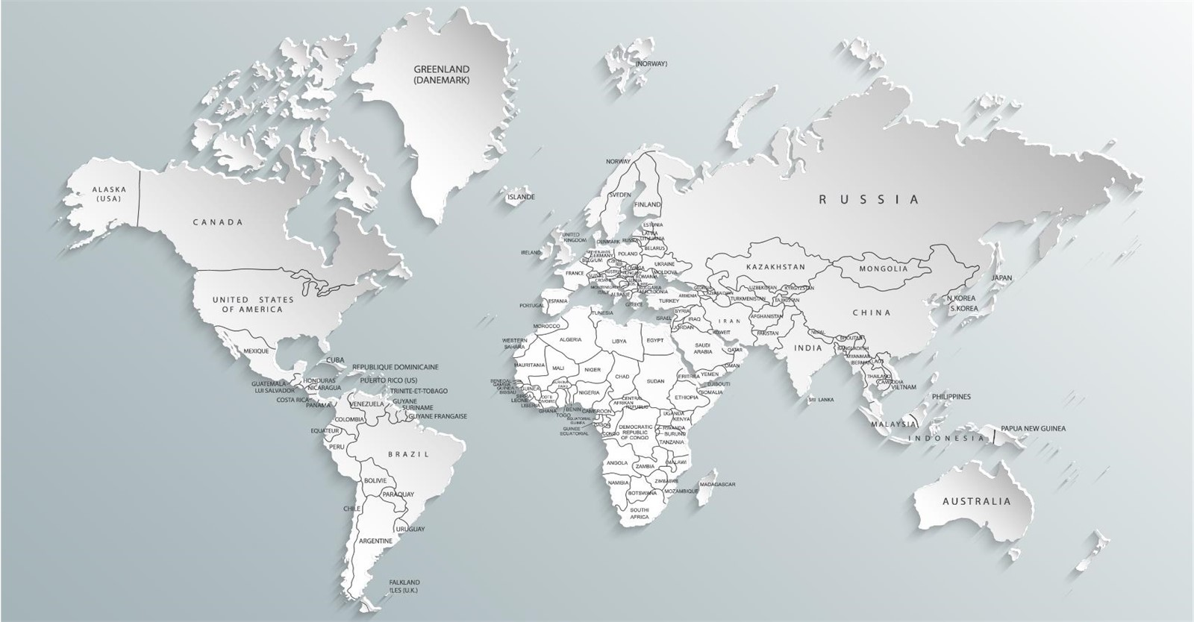
Proyectos de SmartCities
14
10
21
14
11
45
7
7
6
12
52
22
8
7
Desplegadas en
16
+450
9
4
ciudades
20
5
Conectando
+100K
53
10
6
Camaras HD

Slide 8

Proyectos RADWIN de Tren & Metro
Cubriendo > 1,500 km de vias ; Conectando > 1,300 trenes
Moscow
UK
Barcelona
Pisa
Kansai
Utah
Wuhan
Orlando
Chongqing
Changsha
Honolulu
Toluca Mexico
Medellin
Argentina

Slide 9
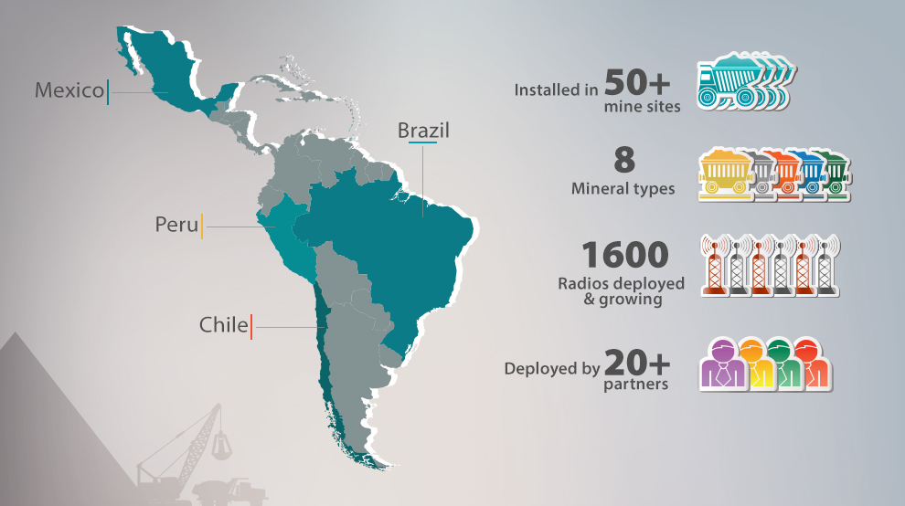

Radwin en Mineria - LATAM
Operando en 60+
Operaciones mineras
10
Minerales distintos
4,000
Radios desplegadas
40+
Partners Integradores

Slide 10

RADWIN solutions for oil & gas

Slide 11

Onshore
Remote sites connectivity
Operational video monitoring
Nomadic connectivity to mobile drillers and offices
Telemetry (AMI), SCADA
Backhaul to Industrial IoT
Offshore
Rig-to-shore connectivity
Rig-to-rig
Oil rigs to vessels connectivity
Ship-to-ship

Slide 12
Digital oil field
Asset management supported by a modern decision-making system to:
Increase Reserves
Optimize Reservoir Damage
Improve Production & Operations
Lower Costs & Capex
1
Decision Solution Selection
2
Analysis Solution Options
3
Surveillance Proactive Problem Detection
4
Data Cleansing and Preparation
HOW?
Real time, targeted data and
information transmission
Modelling and visualization technology
Remote control systems
5
Data Management
6
Data Transmission
7
Measurements Real Time, episodic and other data

Slide 13
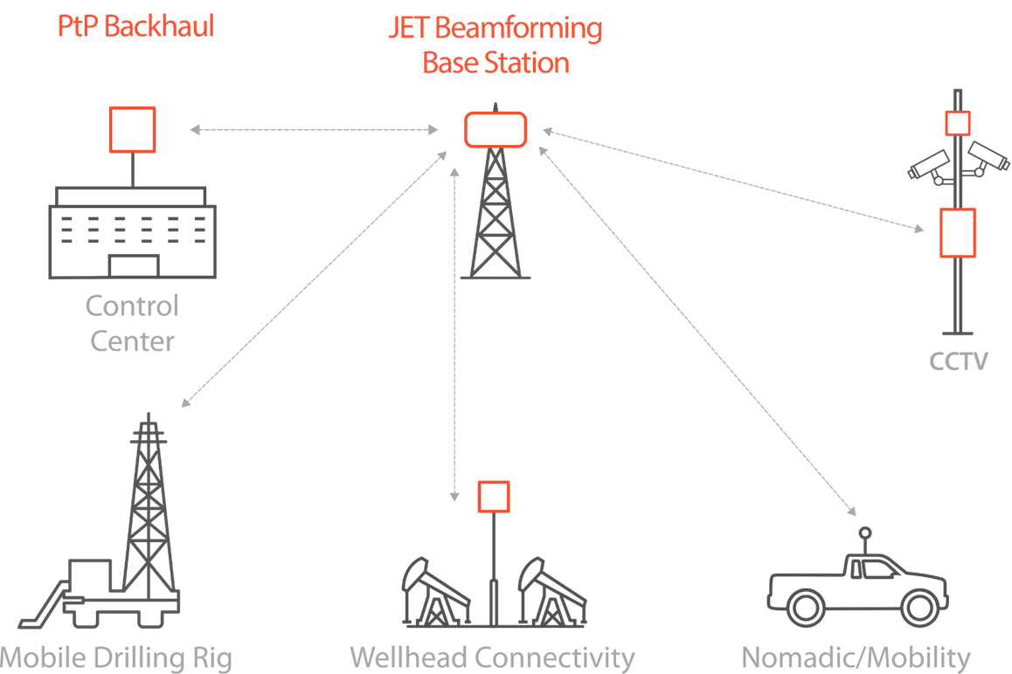
RADWIN solutions for digital oil fields
Real time transmission of:
    Video surveillance
    Temperature sensors
    Pressure sensors
    Loading sensors
    SCADA
    Smart control

Slide 14

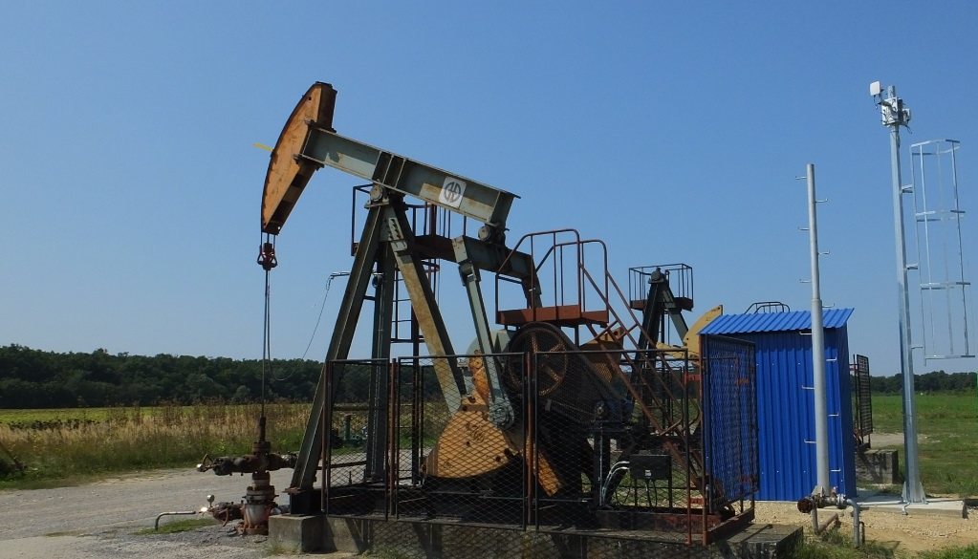
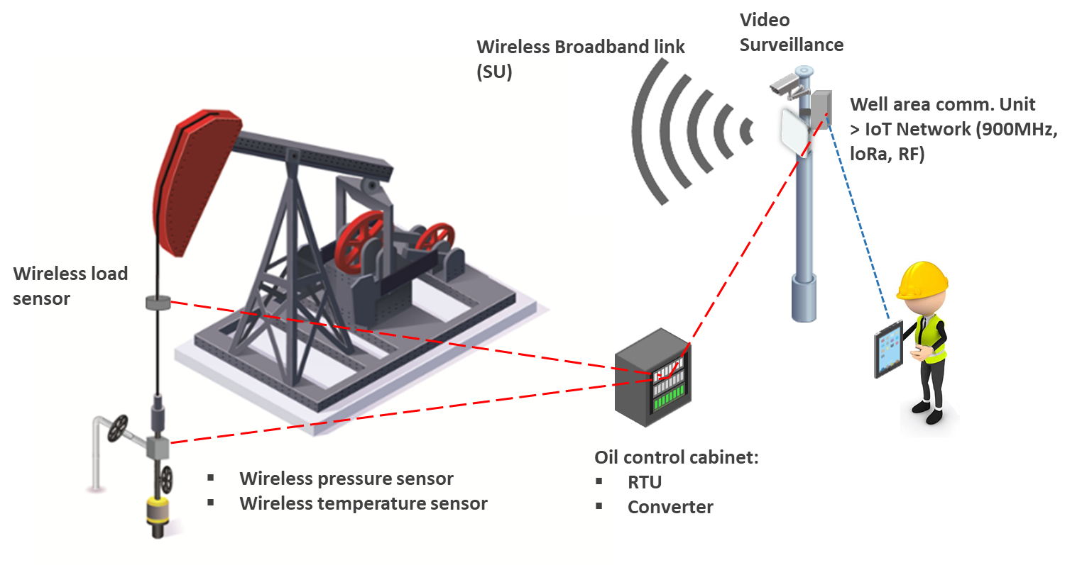
Digital oil field
RADWIN JET
Nomadic/Mobility
RADWIN 2000
RADWIN JET
Notes:
Talk about the solution architecture

Slide 15
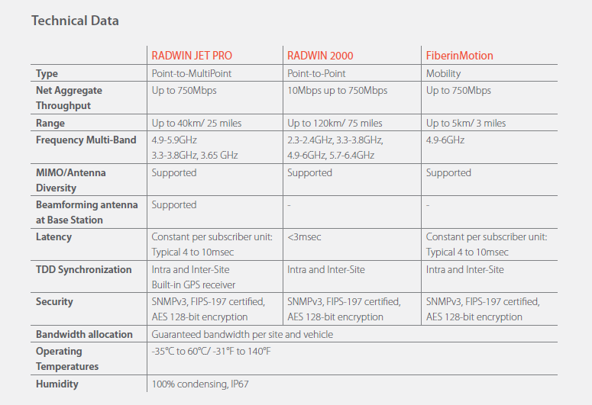

Slide 16
















Proven record of success: digital oil and gas fields
2nd largest oil
company in the world
3rd largest oil
company in the world
Shengli
Zhongyuan
JiangHan
North West
DaGang
JiDong
Hua Bei
Bo Hai
Tarium
XinJiang
JiangHan
liaoHe
YuMen
DaGang
TuHa
Notes:
successful case studies from the largest oil companies – sinopek and cnpc in China
and many other in the US.

Slide 17
Case studies

Slide 18

Shengli digital oil field, China
Massive broadband network to connect video cameras, voice and SCADA
Shengli Oil Field, China
Notes:
2nd largest oil field in China
650K barrels/day
1100 HBSs & 17K HSUs installed
Connecting 25,000 oil rigs/wells, CCTV cameras as well as voice and data connectivity
RADWIN solution was defined as “the only excellent product”

Slide 19
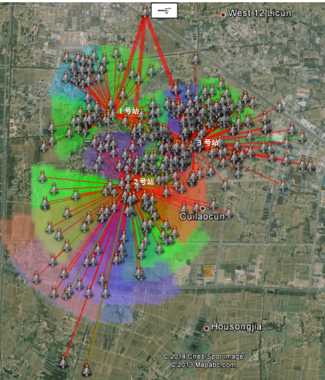
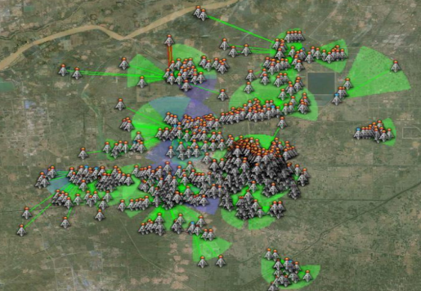
Sinopec digital oil fields, China
Connecting hundreds of video cameras and wells
Notes:
Connecting hundreds of video cameras and wells

Slide 20
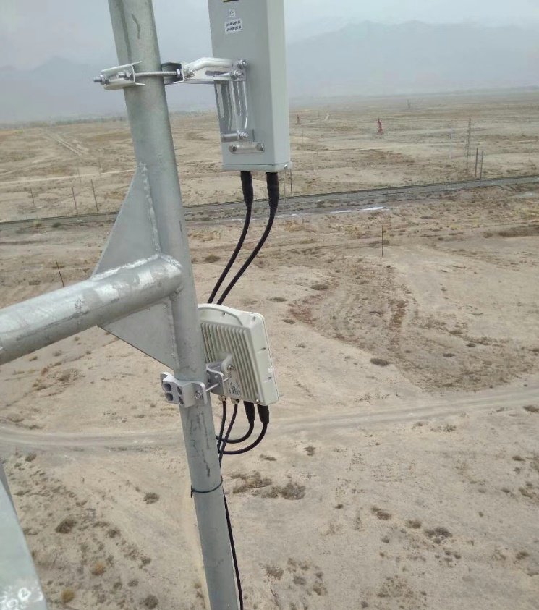
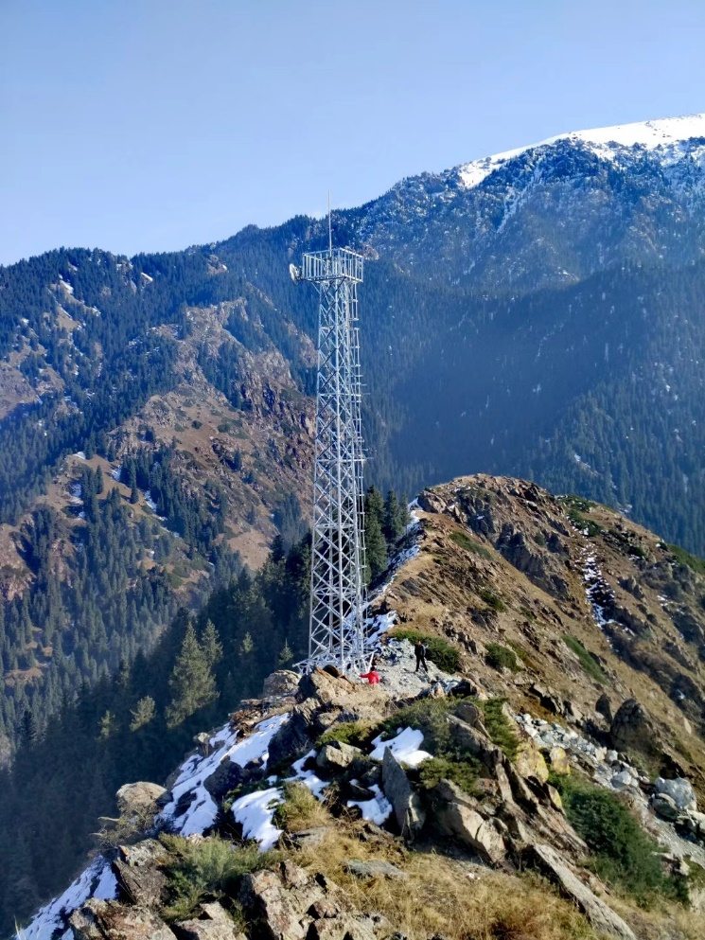
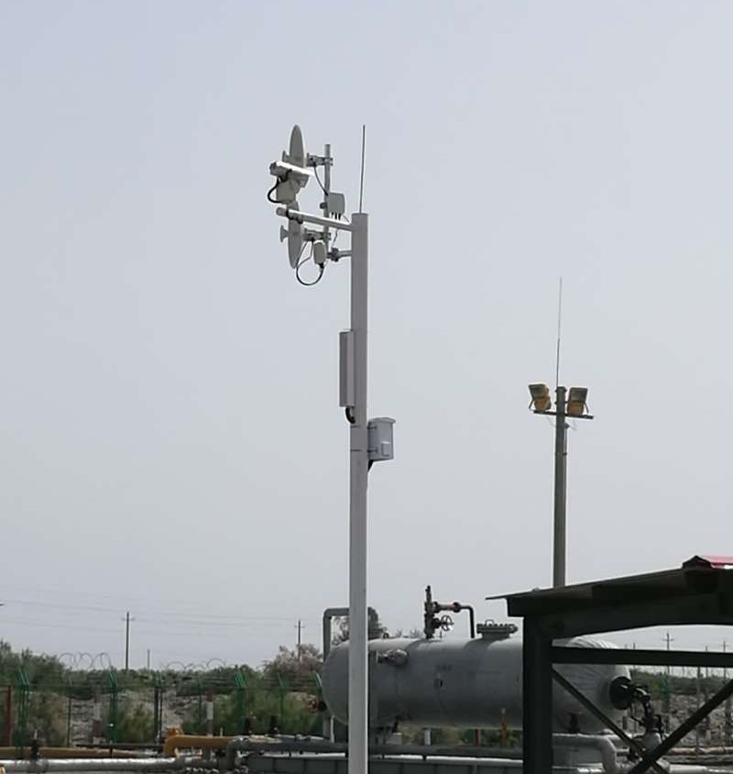
Xinjiang oil field, China
Seamless connectivity for oil fields in the remote northwestern Xinjiang region, China

Slide 21
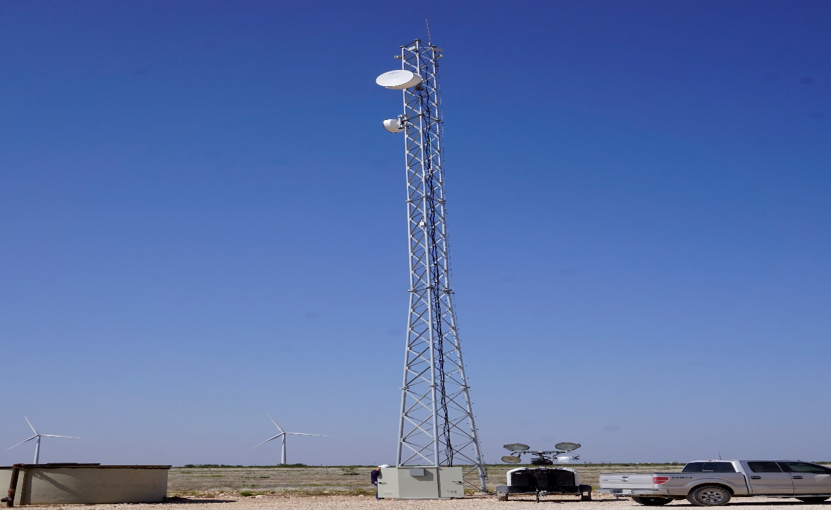

Oil field, Laredo, Texas, USA
Monitoring remote rigs and connecting CCTV cameras, Texas, USA
Notes:
Oil and Gas Customer in Laredo, TX
16 JET’s on 4 Towers, qty.125 SU’s (Phase 1)
application is to monitor remote Rigs and scale to add video surveillance 2019.
Very good collaboration with our Partner “E2E”
Previous using Cambium 450 but network was unreliable, very noisy unlicensed environment.
2019 – Will add Jet’s to qty.4 additional Towers with addtl’ qty.200 SU’s.

Slide 22
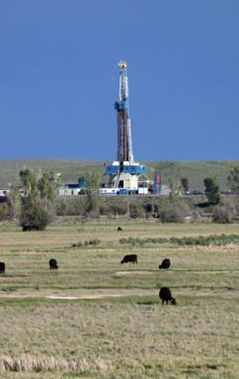
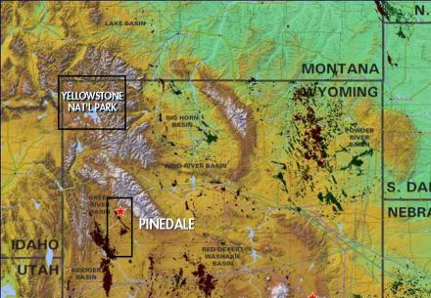
Large natural gas field deployment, USA
Connectivity of real time monitoring over a long range
Notes:
QEP Resources, USA
Nomadic broadband solution
150 sq. miles !!
Real time monitoring and data collection

Slide 23
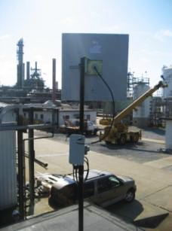

Shell Oil chooses RADWIN
Connecting control equipment to monitoring center on site in extreme nLOS situations shooting through metal pipes
Notes:
T1s in oil refineries
Connect control equipment to monitoring center on site (telemetry)
Extreme nLOS situations shooting through metal pipes
Operation even in nLOS
Excellent performance – met Shell’s high performance & quality requirements

Slide 24
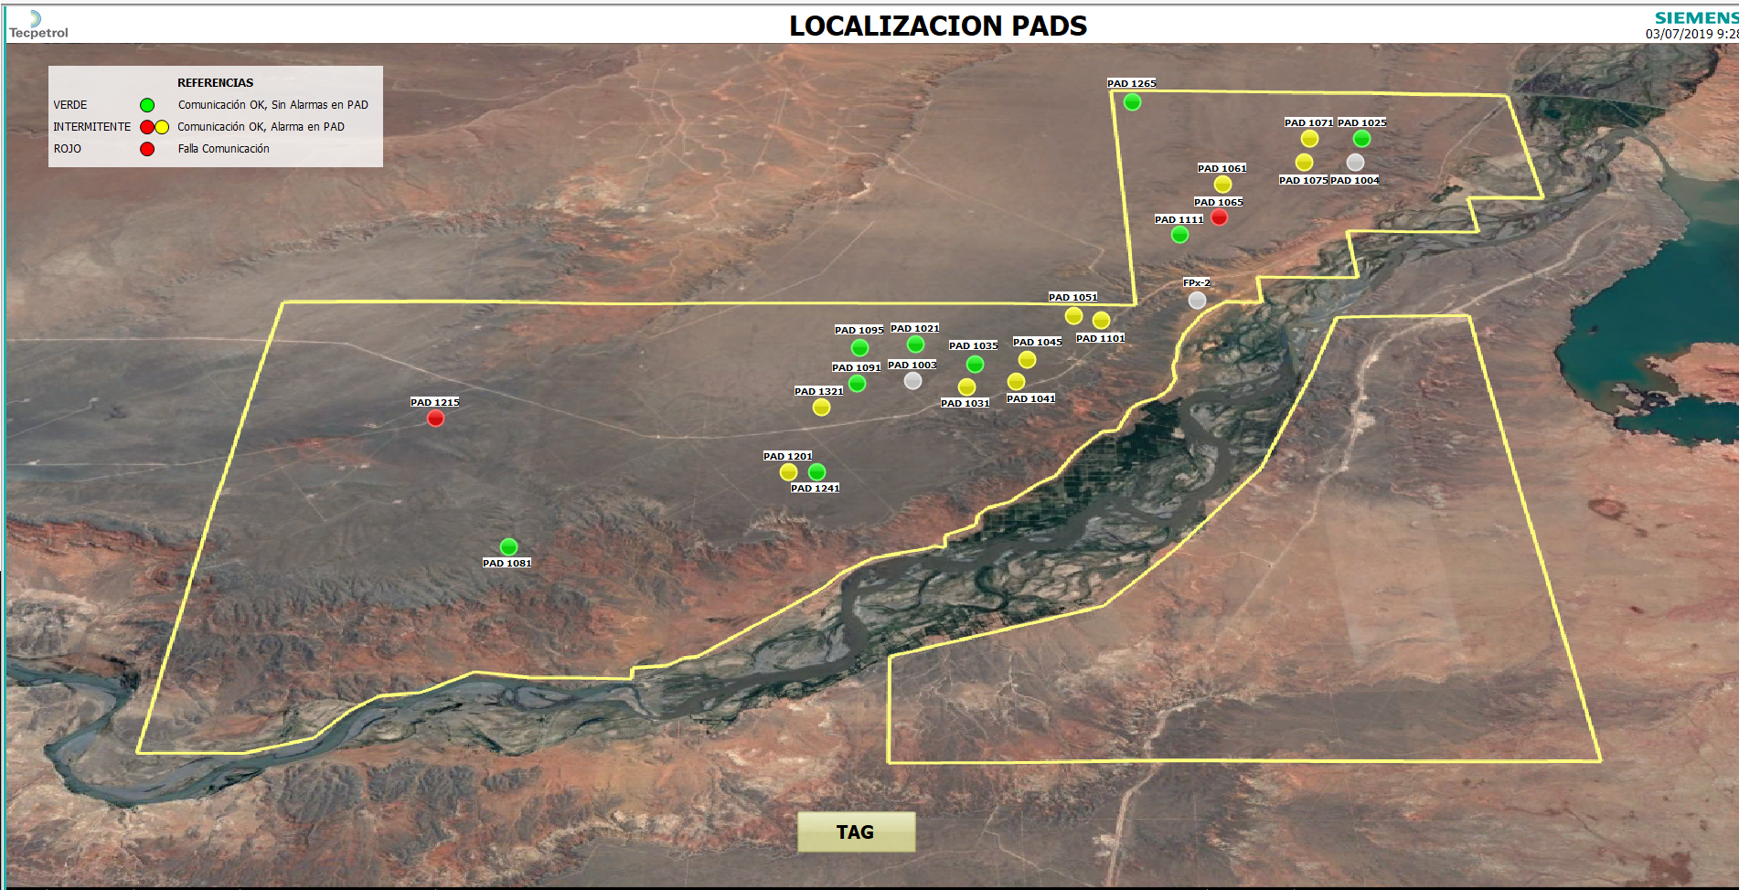
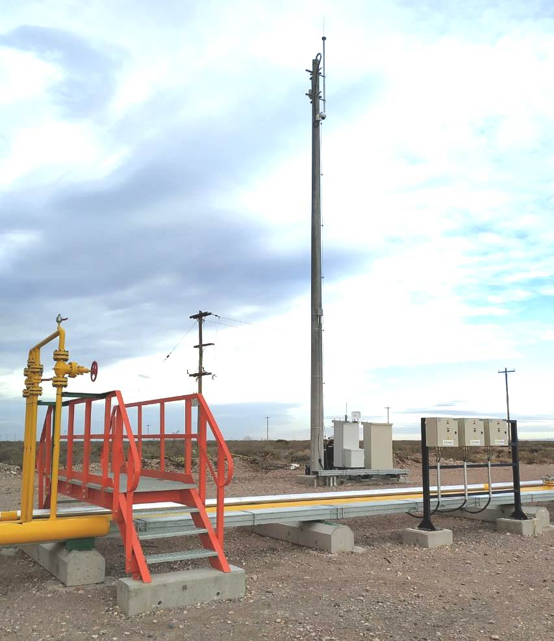
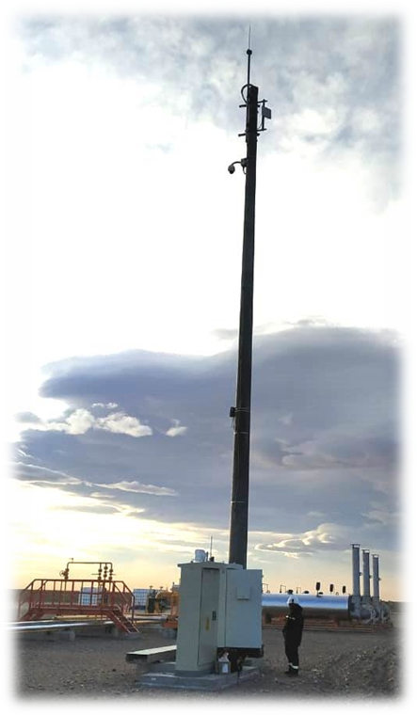
Yacimiento Shale Gas
Fortín de Piedra (Vaca Muerta) Neuquén – Argentina.
• Base Stations Jet PRO (HBS) were mounted on antennas at batteries facilities (9 nine).
• Subscribers to were located on Wells Pads facilities (95 Wells Pads)
• Traffic include: SCADA Data Services, Corporate LAN (Local Access Point WIFI in PAD), Remote maintenance Access and Video security.
Fortin de Piedra Shale´s Gas Project actually produces 16 MMcf/d and was became the biggest gas production field in Argentina in just 1 year.
Notes:
QEP Resources, USA
Nomadic broadband solution
150 sq. miles !!
Real time monitoring and data collection

Slide 25
Thank you

